Slide 1
Detection of DTMF Key by Goertzel Algorithm and accuracy inspection
For – EECE 312 – DSP Laboratory

Slide 2
Group – 4 Group Members:
Galib – Ul – Alim | 202016057
Fardin Shahab | 202016008
Syed Nazmus Sakib | 202016051
Lt Saiman |201816154
Lt Saleh |201816155
Lt Tahmid |201816158

Slide 3
Objectives of the project
To detect DTMF signals using Goertzel Algorithm.
To observe the accuracy of the implemented method through addition of noise.

Slide 4
What is DTMF?
Frequency | 1209 Hz | 1336 Hz | 1477 Hz
697 Hz | 1 | 2 | 3
770 Hz | 4 | 5 | 6
852 Hz | 7 | 8 | 9
941 Hz | * | 0 | #
Dual Tone Multi Frequency is the international standard encoding procedure to encode digital buttons.

Slide 5
Why is it used?
DTMF is used for user end to send key presses and commands to the other end where the receiving end is a computer designed to pick up the key press.
Examples may entail –
Networking companies asking for inputs through keypad presses.
Ships where remote signals are required.
Any other remote instructions that requires simple encoding so that it is not picked up by any other signal systems.

Slide 6
Algorithm used by the companies
Transmission
Channel
Detected Key
The key is detected
Transmitted through networking channel
Key Input
Use of Filter Bank
From the User End
General mechanism /
Algorithm

Slide 7
What we are trying to do
Transmission
Channel
Detected Key
The key is detected
Transmitted through networking channel
Key Input
Goertzel Algorithm
From the User End
New mechanism /
Algorithm

Slide 8
Goertzel Algorithm in short -
Goertzel Algorithm is a form of DFT (Discrete Fourier Transform), however, it has some significant differences. Goertzel algorithm works with only a set of
given coefficients. As a result, unnecessary values calculated through FFT and DFT are not required here. It is therefore much faster and convenient for this project.

Slide 9
Procedure followed
01
02
03
04
Key Pressed
The DTMF for that key
Is generated (in time domain)
The Power Spectral Density is generated (for analysis)
The Goertzel algorithm is used for the 7 required frequencies.

Slide 10
Procedure followed
05
06
The highest peaks are determined.
There concurrent frequency values are determined
07
The peaks are compared with set DTMF frequencies
08
The key is detected.

Slide 11
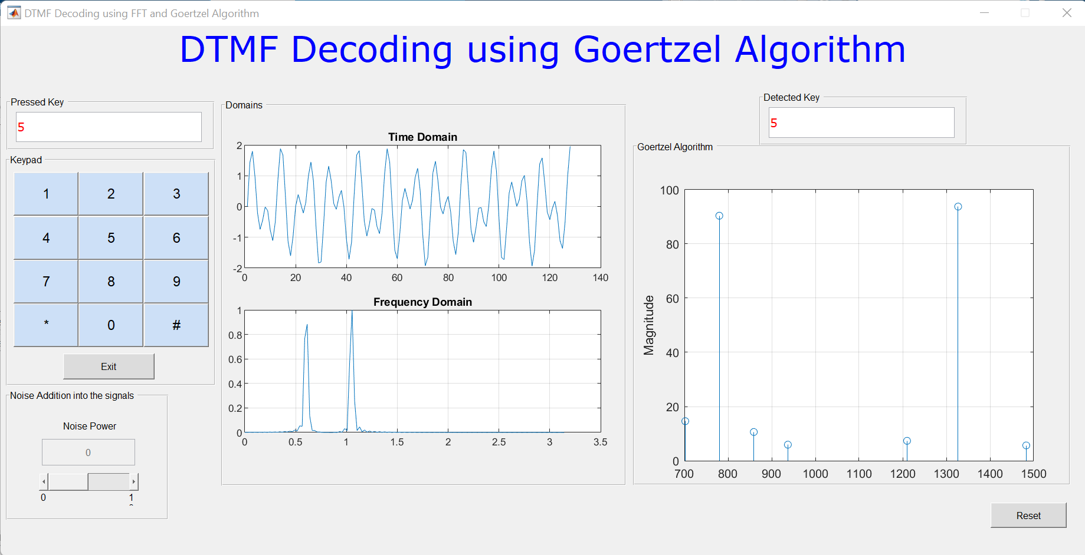
1
Key Pressed

Slide 12
2
The DTMF for that key
Is generated (in time domain)

Slide 13
3
The Power Spectral Density is generated (for analysis)

Slide 14
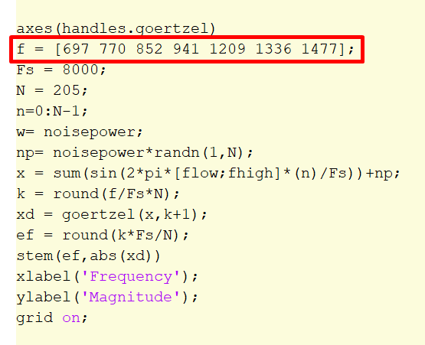
4
The Goertzel algorithm is used for the 7 required frequencies.

Slide 15
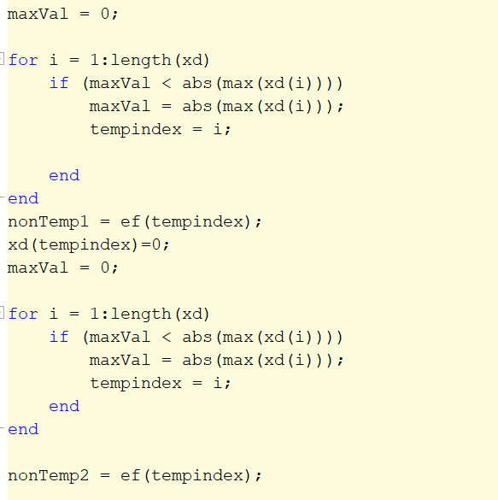
5
There concurrent frequency values are determined
The highest peaks are determined
6
Here, the array is run through, and the highest value is determined. Then the highest value is removed and next highest value is determined.
We remember that the plot requires two arrays of the same size and thus finding the highest peak at y axis at certain indices will give us a concurrent indices for x axis.
X axis here contains the required Frequencies.

Slide 16
~Our Goertzel Output and the Detected Key
Remember the DTMF table?
Frequency | 1209 Hz | 1336 Hz | 1477 Hz
697 Hz | 1 | 2 | 3
770 Hz | 4 | 5 | 6
852 Hz | 7 | 8 | 9
941 Hz | * | 0 | #

Slide 17
!
Addition of Noise!
Trying to simulate a real life condition

Slide 18
What we did and What we expect
Addition of noise is done by a GUI slider. The string value is the input which is multiplied to the matrix (noise) generated randomly by randn(1,N)
Expectation:
Upto a value, Goertzel should give correct results.
There will be a threshold after which, the detected value will be distorted.

Slide 19
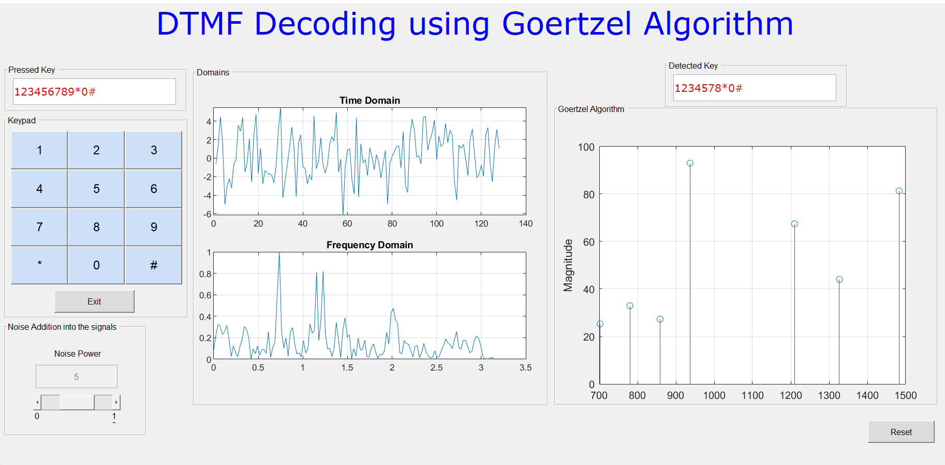
!
Output with noise level 5
We see that the noise level at 5 has a significant difference between the original Time domain Signal and it shows after our analysis (both for PSD and for Goertzel) However the random values do not dominate the inherent frequencies and so we can detect the pressed key.

Slide 20
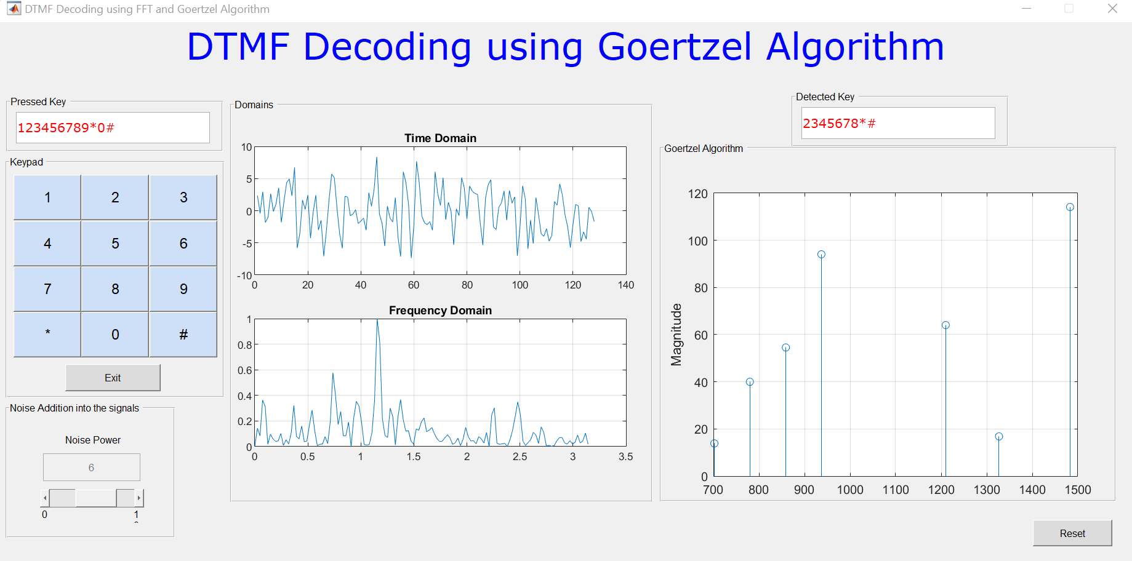
!
Output with noise level 6
At noise level 6, we notice that the detection unit did not detect keys ‘1’, ‘9’ and ‘0’. Therefore the accuracy of detection already started to deteriorate.

Slide 21
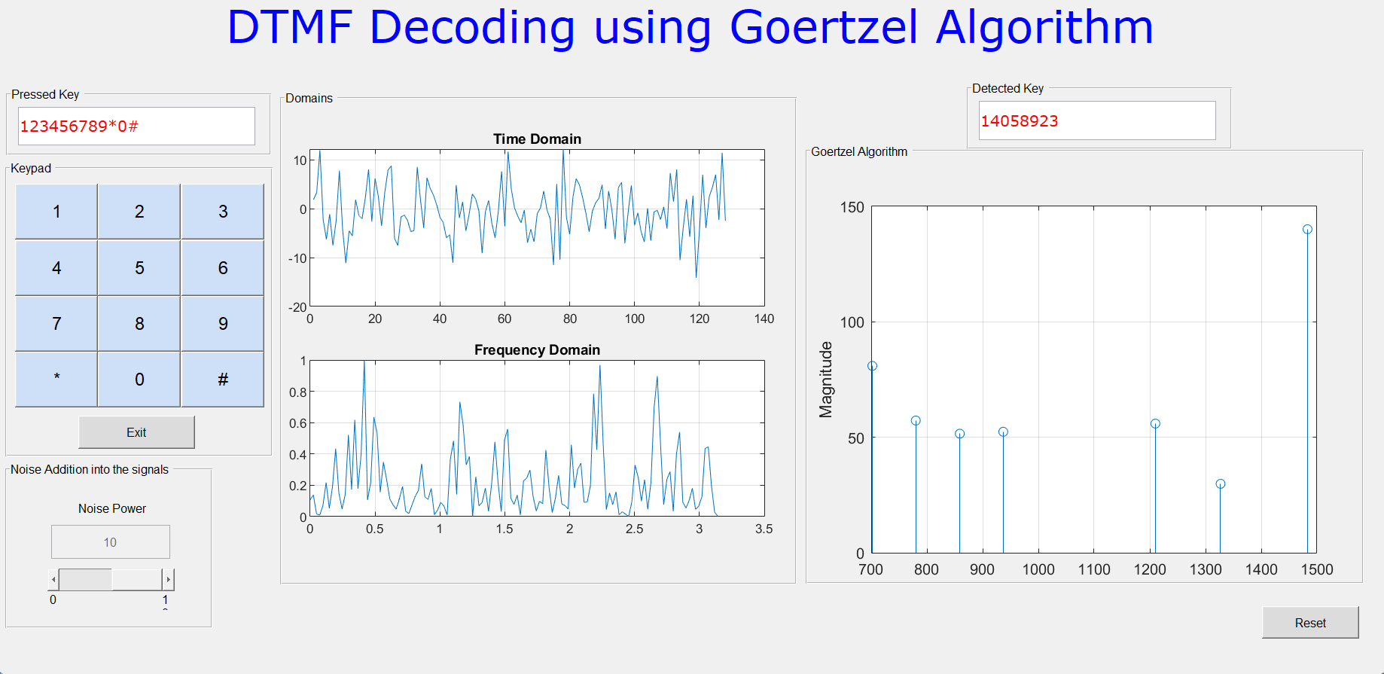
!
Output with noise level 10
At noise level 10, the value detected is not only dropped off as in level 6, the values are also detected wrong, as the noise frequencies dominate and change the maximum obtained frequency after Goertzel.

Slide 22
Observation
Noise level 6
Noise level 10
Noise level 5
Detectable
Mildly Detectable
Undetectable
The value can be detected without any problems
There are some drop offs
Cannot be used as it both drops off values and detects wrong values.

Slide 23
Scopes for Improvement
Filters can be used to reduce or cut off the noise frequencies from the time domain signal.
Networking companies use heavier noise reduction mechanisms, implementing those will allow Goertzel to be used for detection of DTMF without any further issues.

Slide 24
THANKS!
For your kind hearing and patience!
If you have any questions,
please keep them to yourselves
Ask!
Group - 4

